Slide 1


Moving from Policy to Practice: Real World Learnings of Developing & Integrating AI into Healthcare
Dr Rebecca Pope (she/her)
UK Digital & Data Science Lead, Roche UK
M-GB-00021376 | March 2025

Slide 2
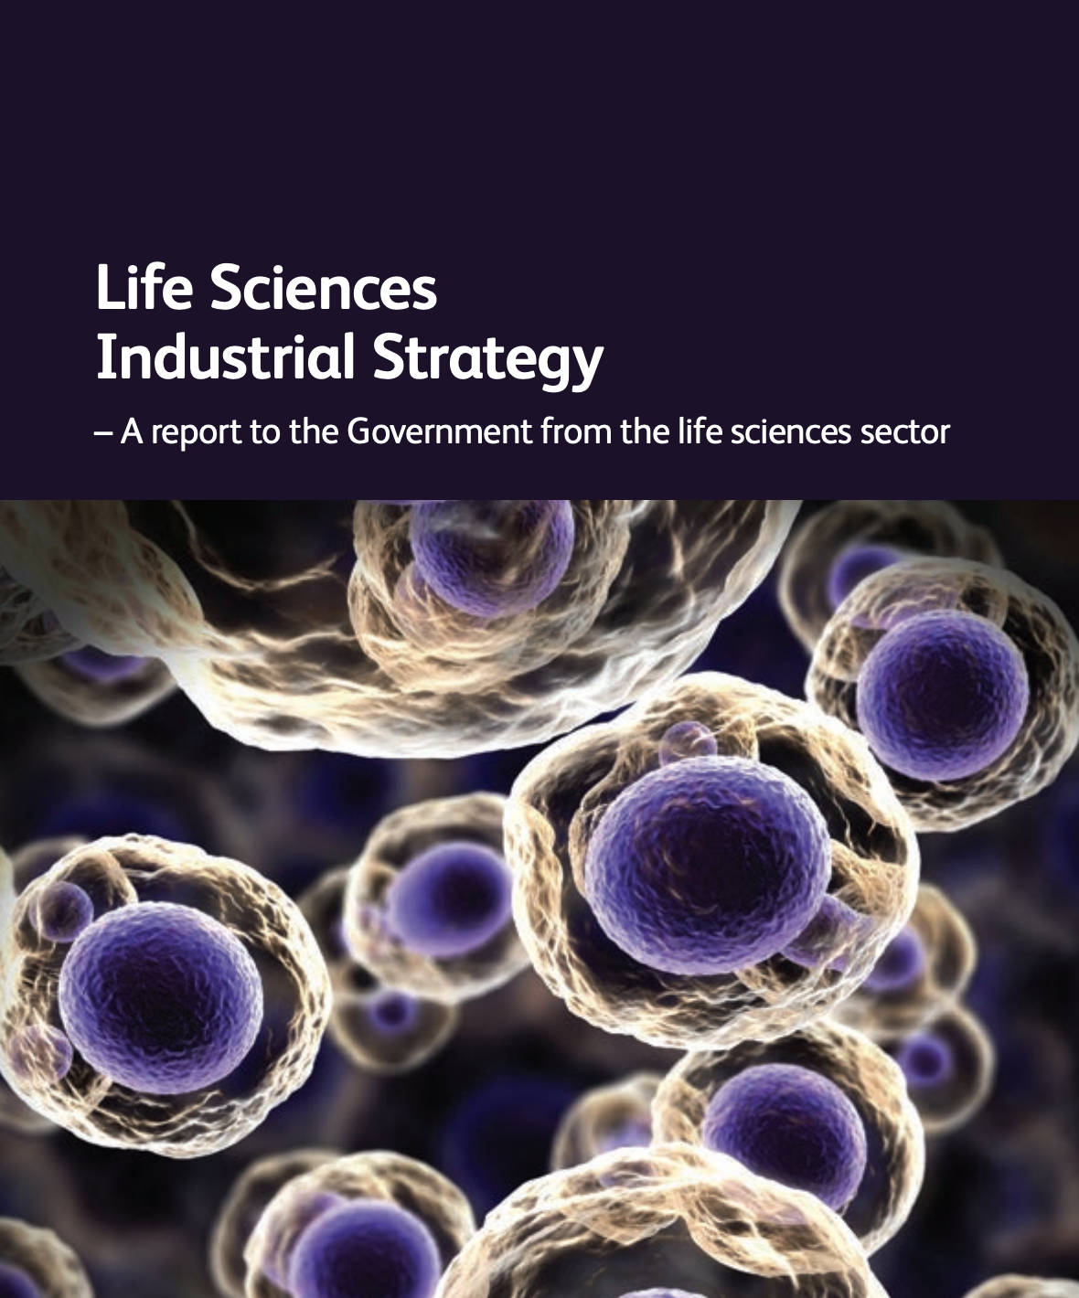
“[The NHS] should work in a new collaborative environment where industry and the health system work together, underpinned by the rich datasets that the NHS can now provide”
Source

Slide 3

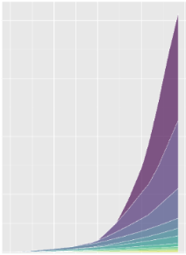

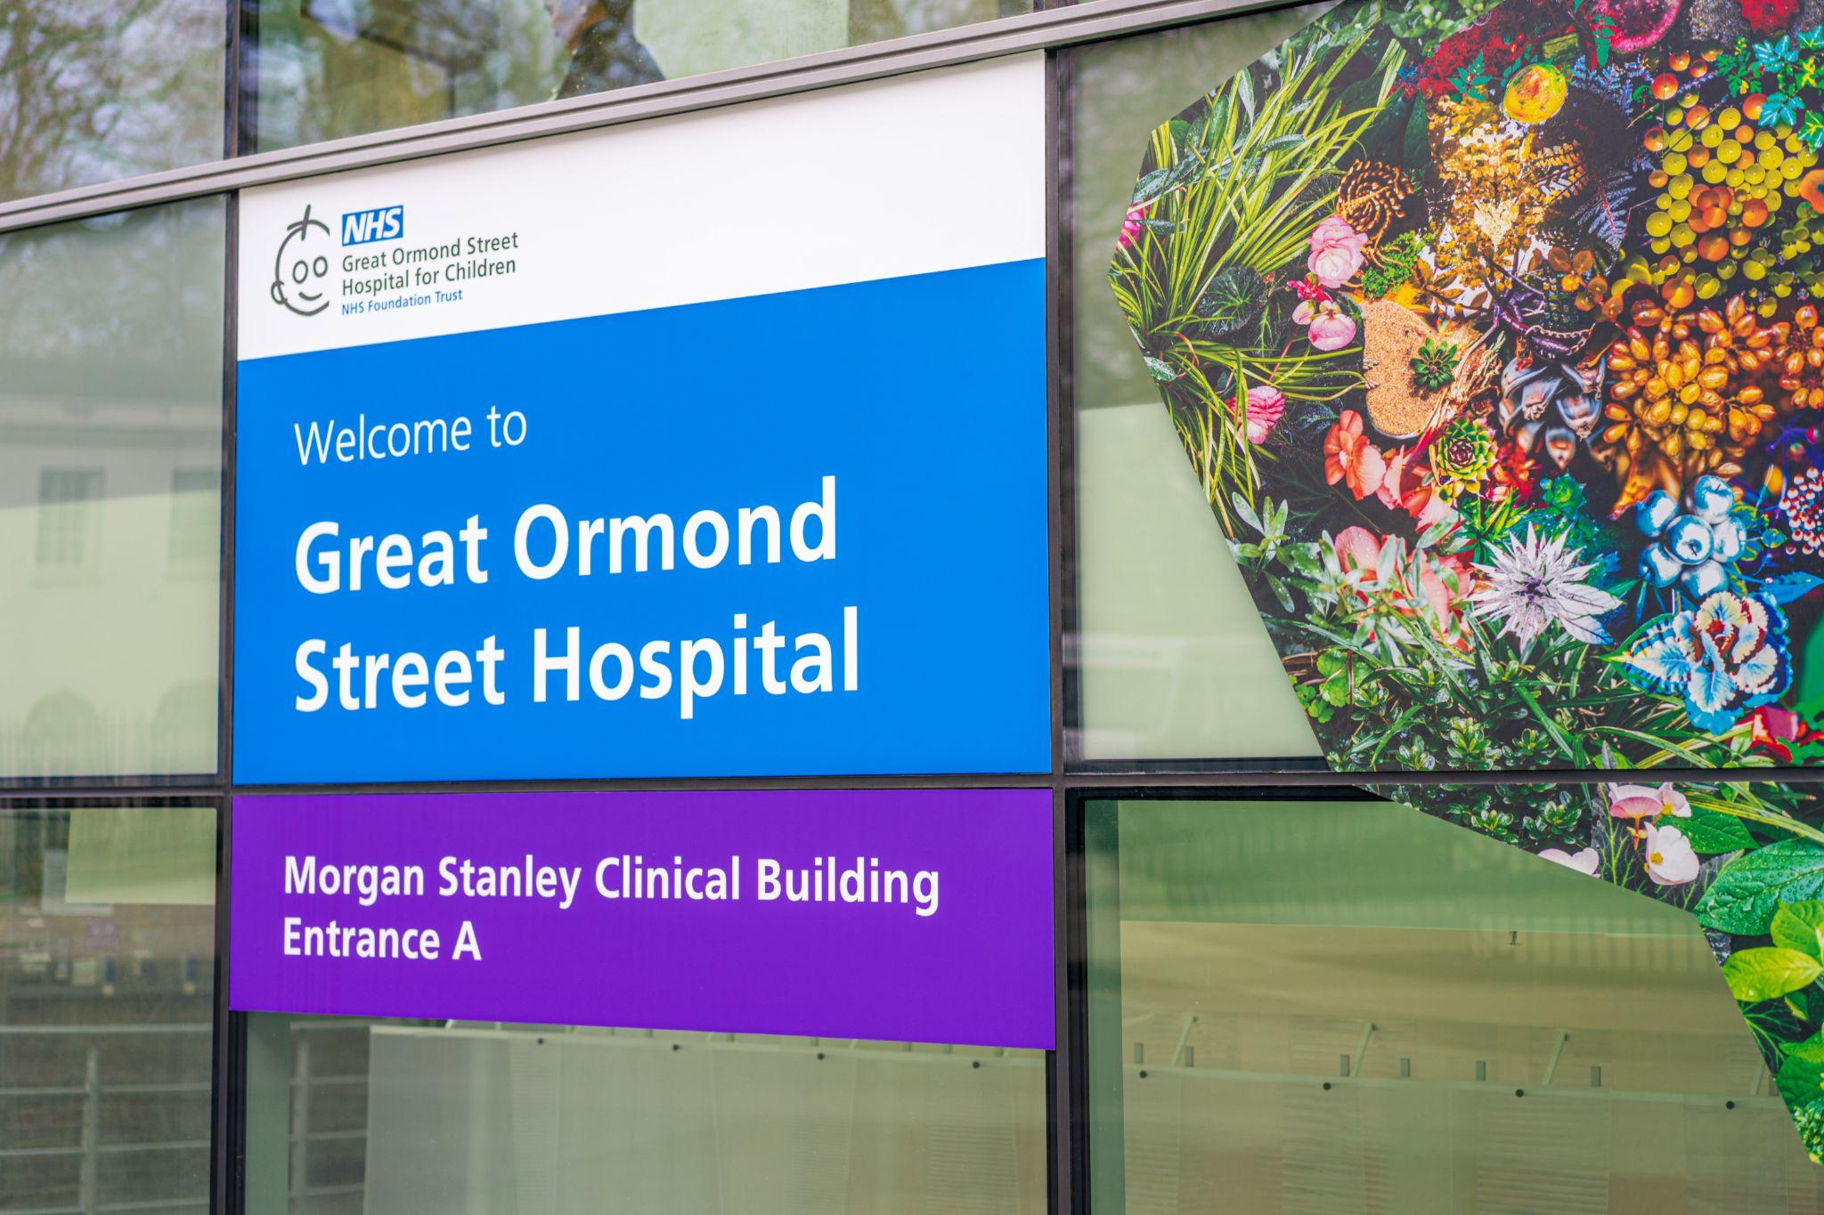
Great Ormond Street Hospital: The Why
Moving from policy to practice…
1bn data points
RWD volume
2010 - 2025
Great Ormond Street Hospital (GOSH) is an international centre of excellence in child healthcare, recognised as one of the most digitally mature Hospitals in the world & leads 1 of 7 Genomic Laboratory Hubs in England.

Slide 4






Great Ormond Street Hospital (GOSH): The How
Roche staff are GOSH DRIVE Honorary Contract holders
Roche staff only access secure, anonymised data
Partnership
Considerations…
Roche staff only use GOSH owned laptops
Roche staff only build code on GOSH Drive’s infrastructure
All Intellectual Property Rights are NHS owned

Slide 5
Great Ormond Street Hospital (GOSH): The What
Genomics
Genomic Data Flowing Across the NHS to Enhance Personalised Healthcare at Scale
Clinical Decision Support
01
04
Embedding data-driven decision support into clinical practice
Clinical Insights Unit
Creating an Exemplar Clinical Insights Unit to Accelerate a Learning Health System
Wearables in real life
Determining the Clinical Utility of Wearable Devices & Remote Patient Monitoring in the Real World
02
05
Information and data sharing across the system
Natural Language Processing
03
How to Share Health Data Quickly to Enhance Clinical Practice
How to use the latest developments in NLP to improve secondary use of data
06
Infrastructure
07
Development of a data science environment that enables analytics and AI model development to enhance clinical decision-making

Slide 6
Genomic Data Flowing Across the NHS to Enhance Personalised Healthcare at Scale, using advanced NLP

Slide 7

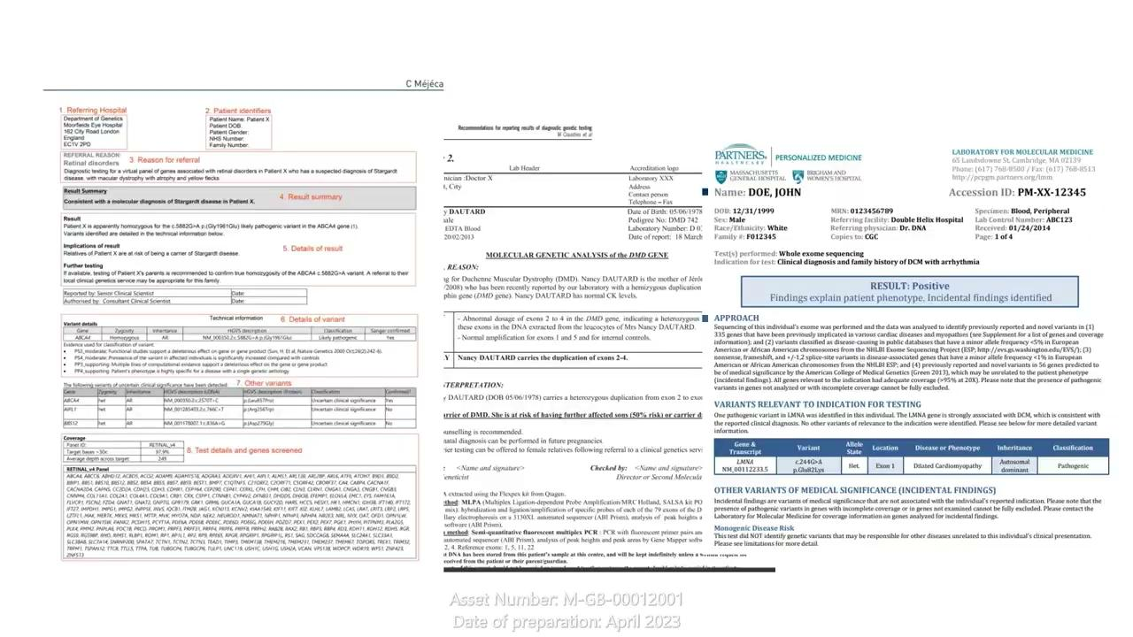

Genomics & NLP
Co-creating an algorithmic stethoscope towards precision medicine
30-fold increase in productivity; from months to hours…

Slide 8
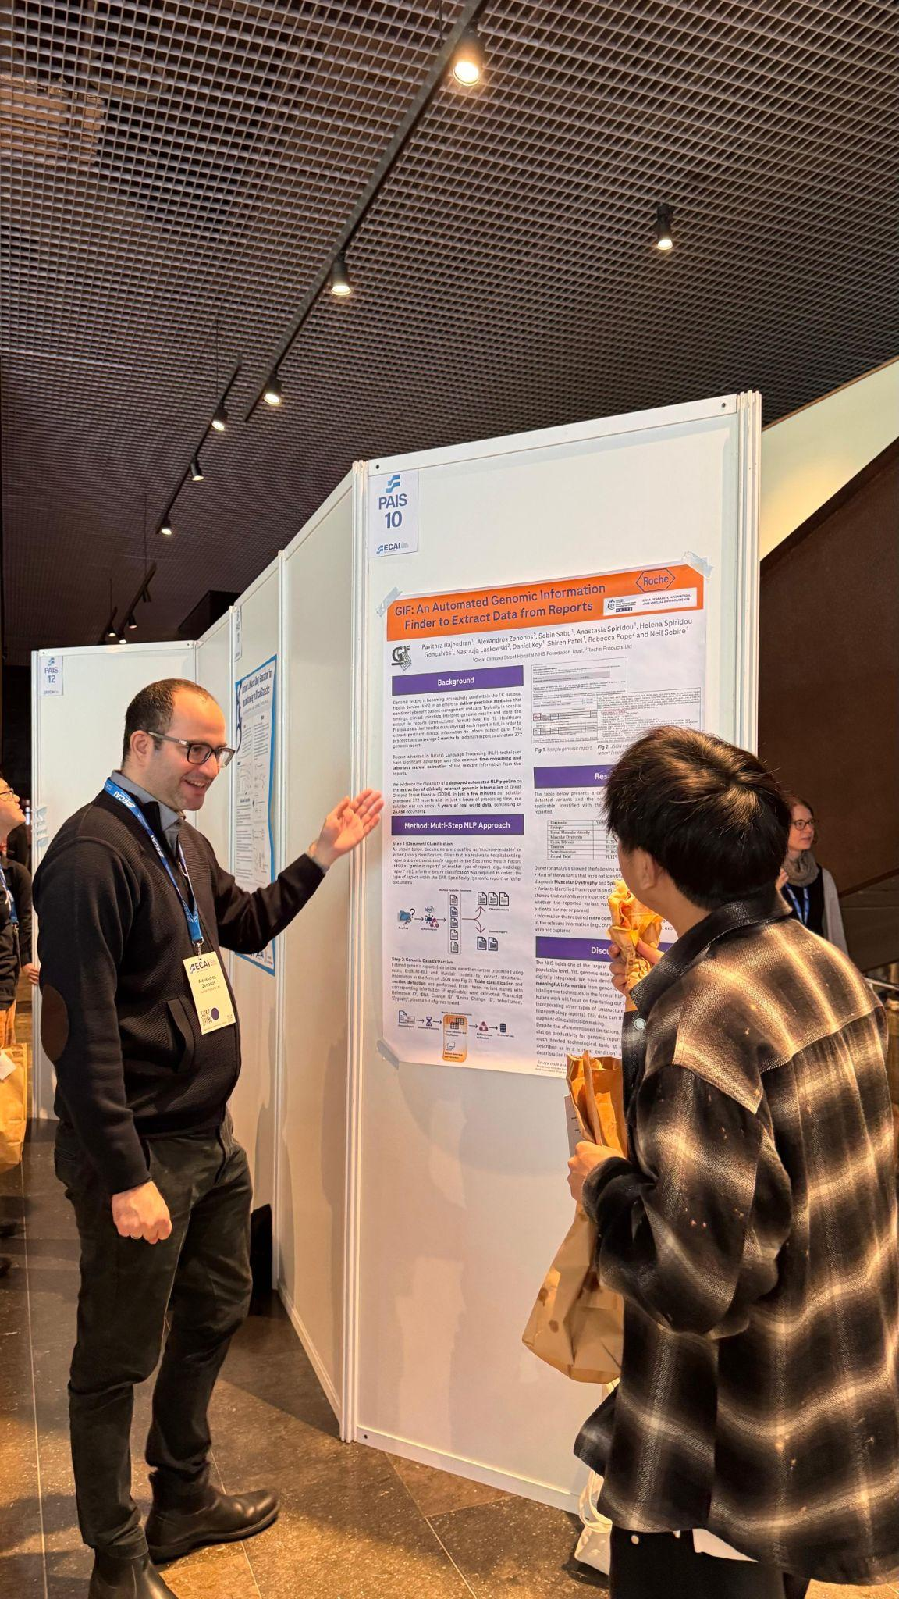
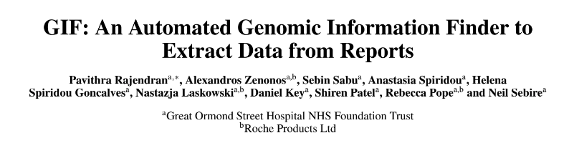


Sharing our System Shaping work across the
NHS & beyond
>>> Work has been accepted for publication & presented at an A-ranked AI conference
>>> Open-source the code base for wider NHS use
GitHub link

Slide 9
Creating an Exemplar Clinical Insights Unit to Accelerate a Learning Health System

Slide 10
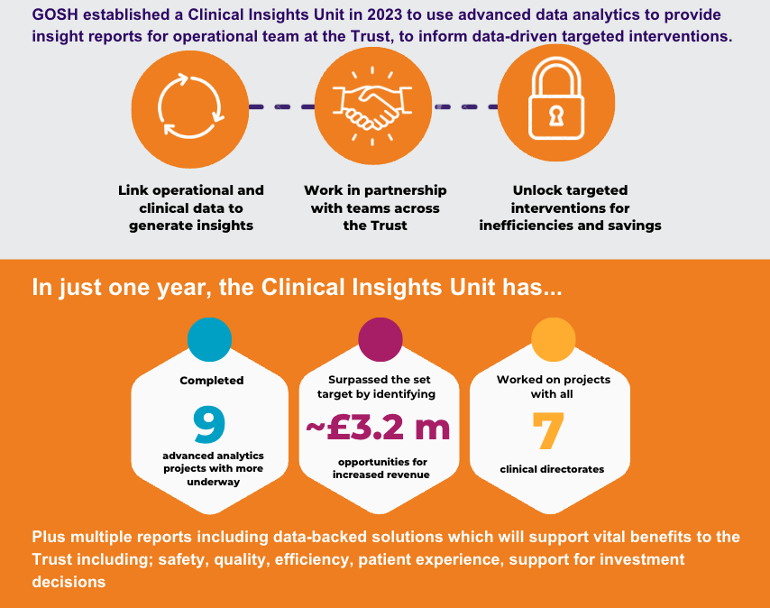
Clinical Insights Unit (CIU)

Slide 11
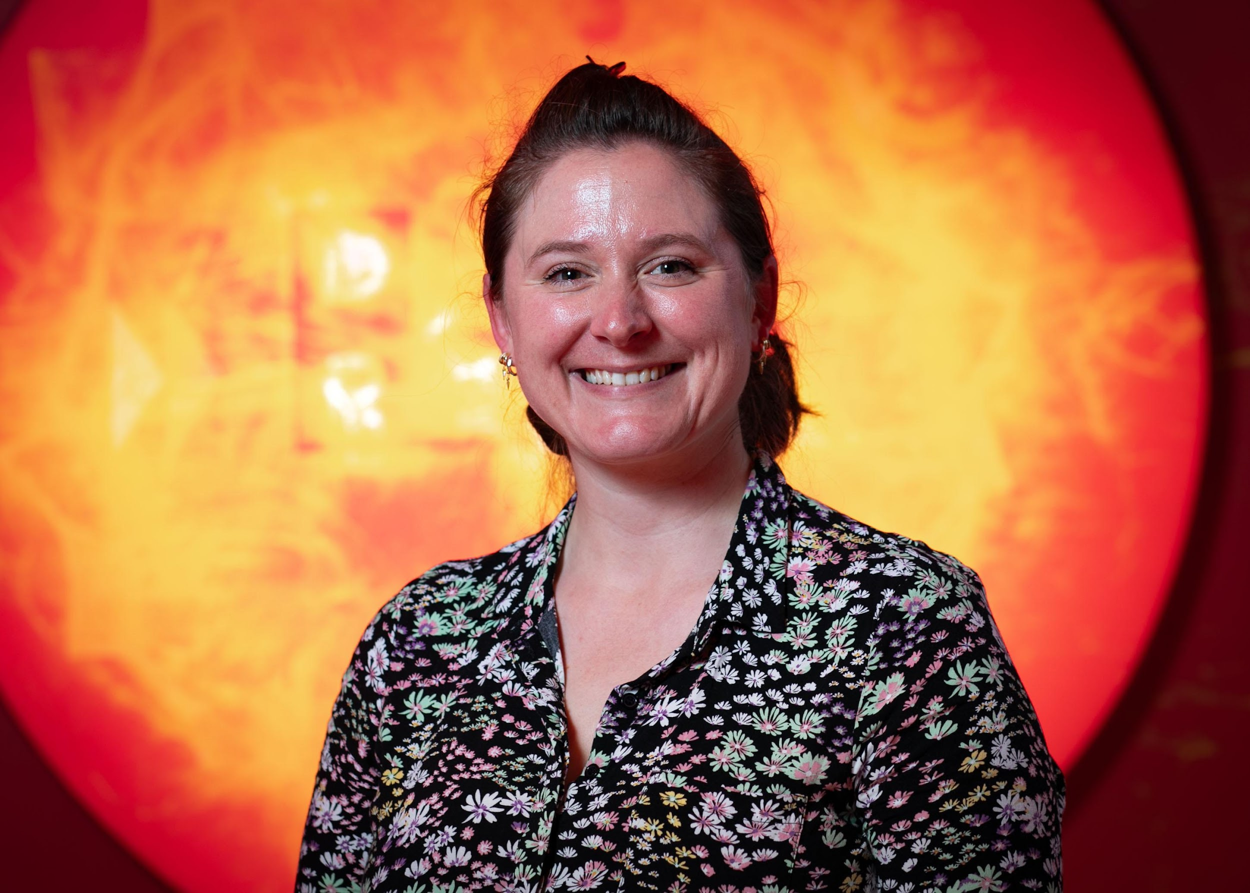
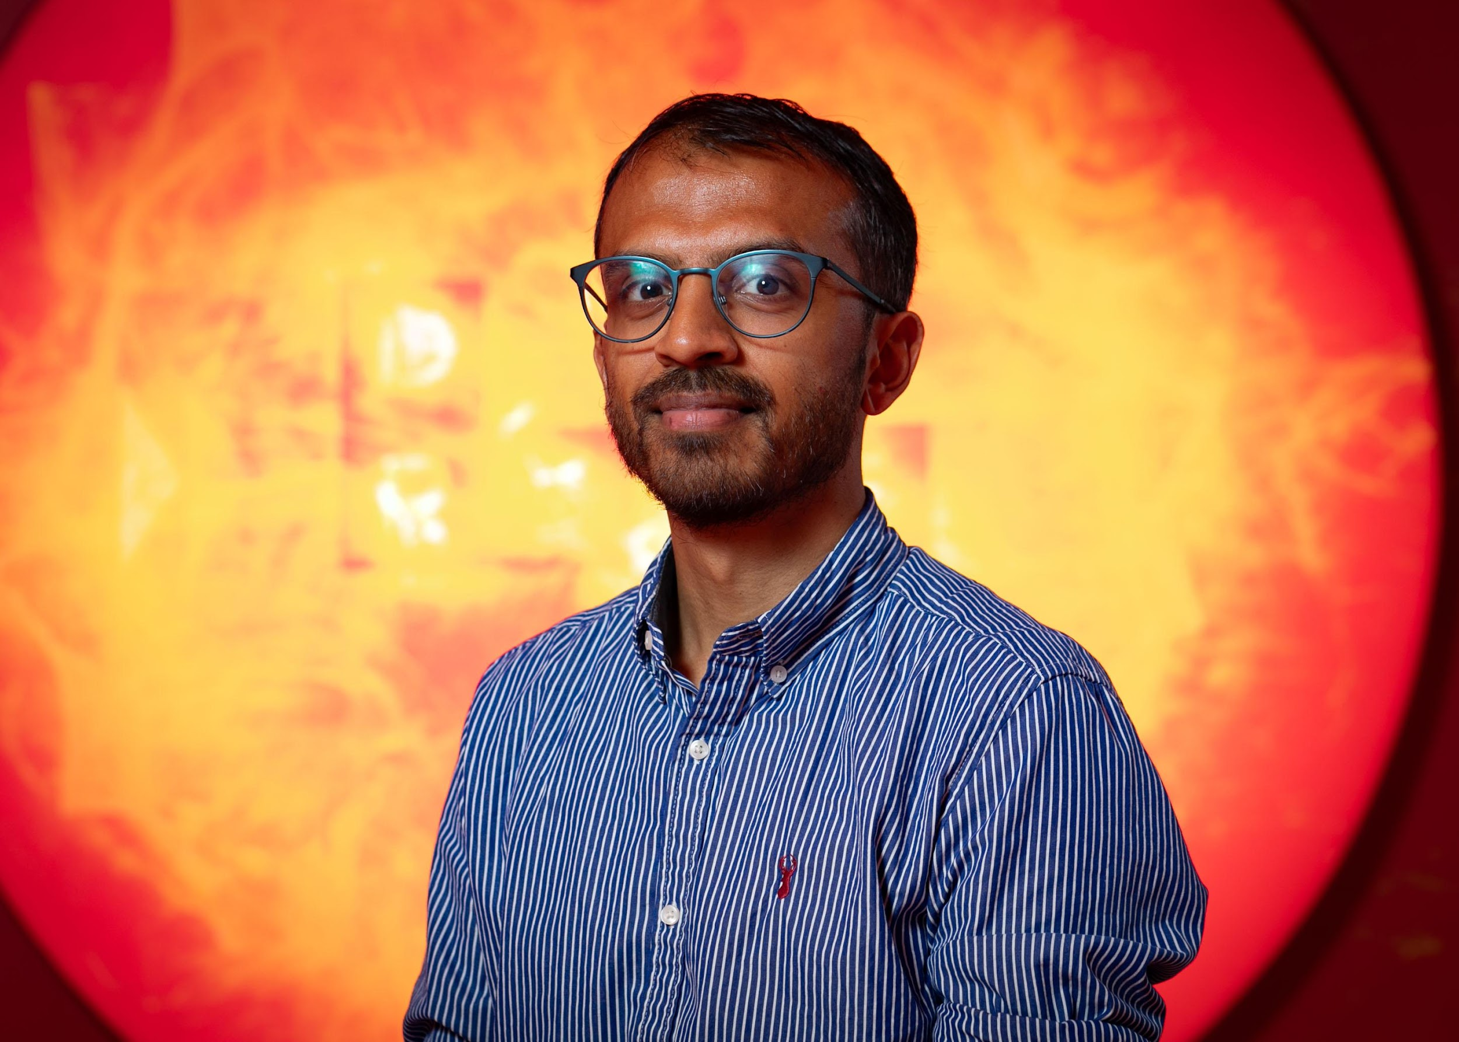
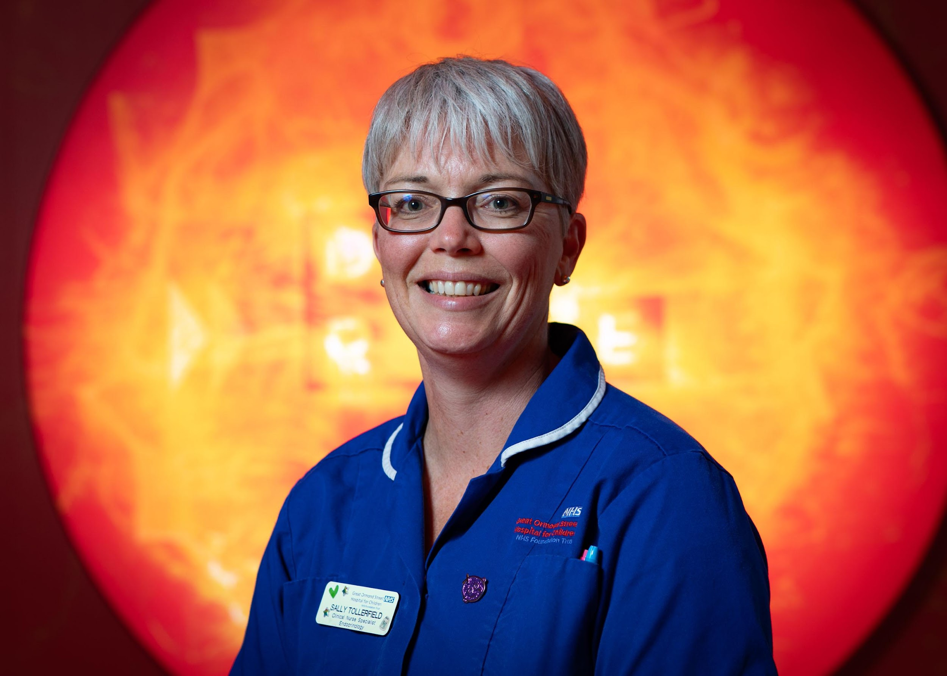
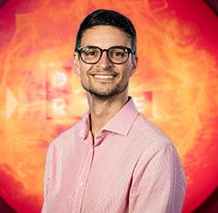
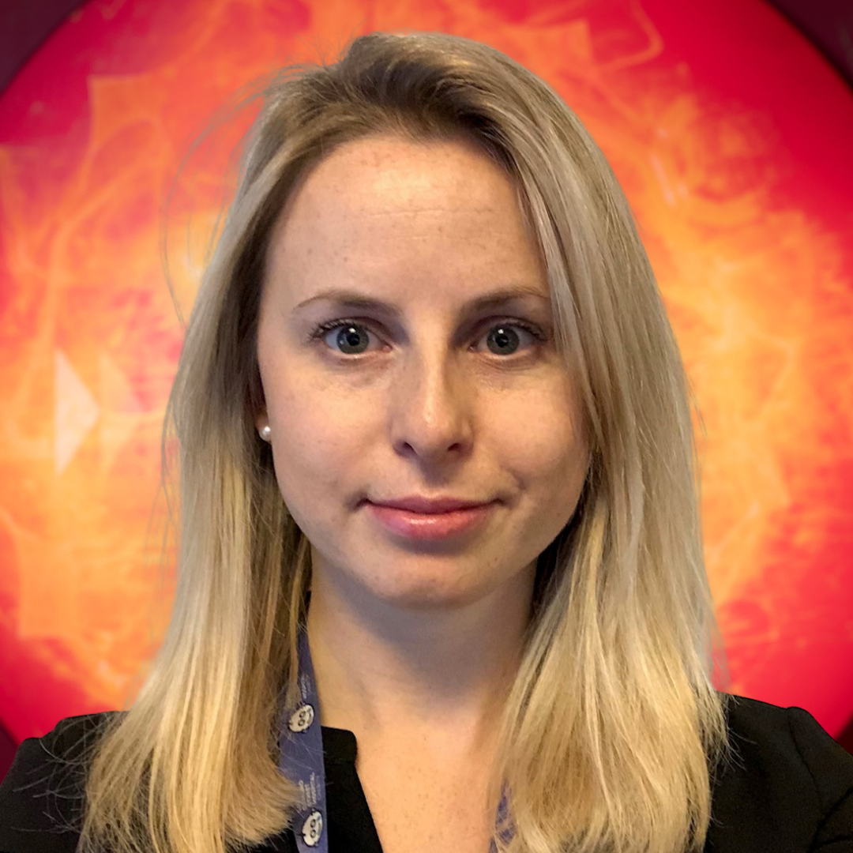
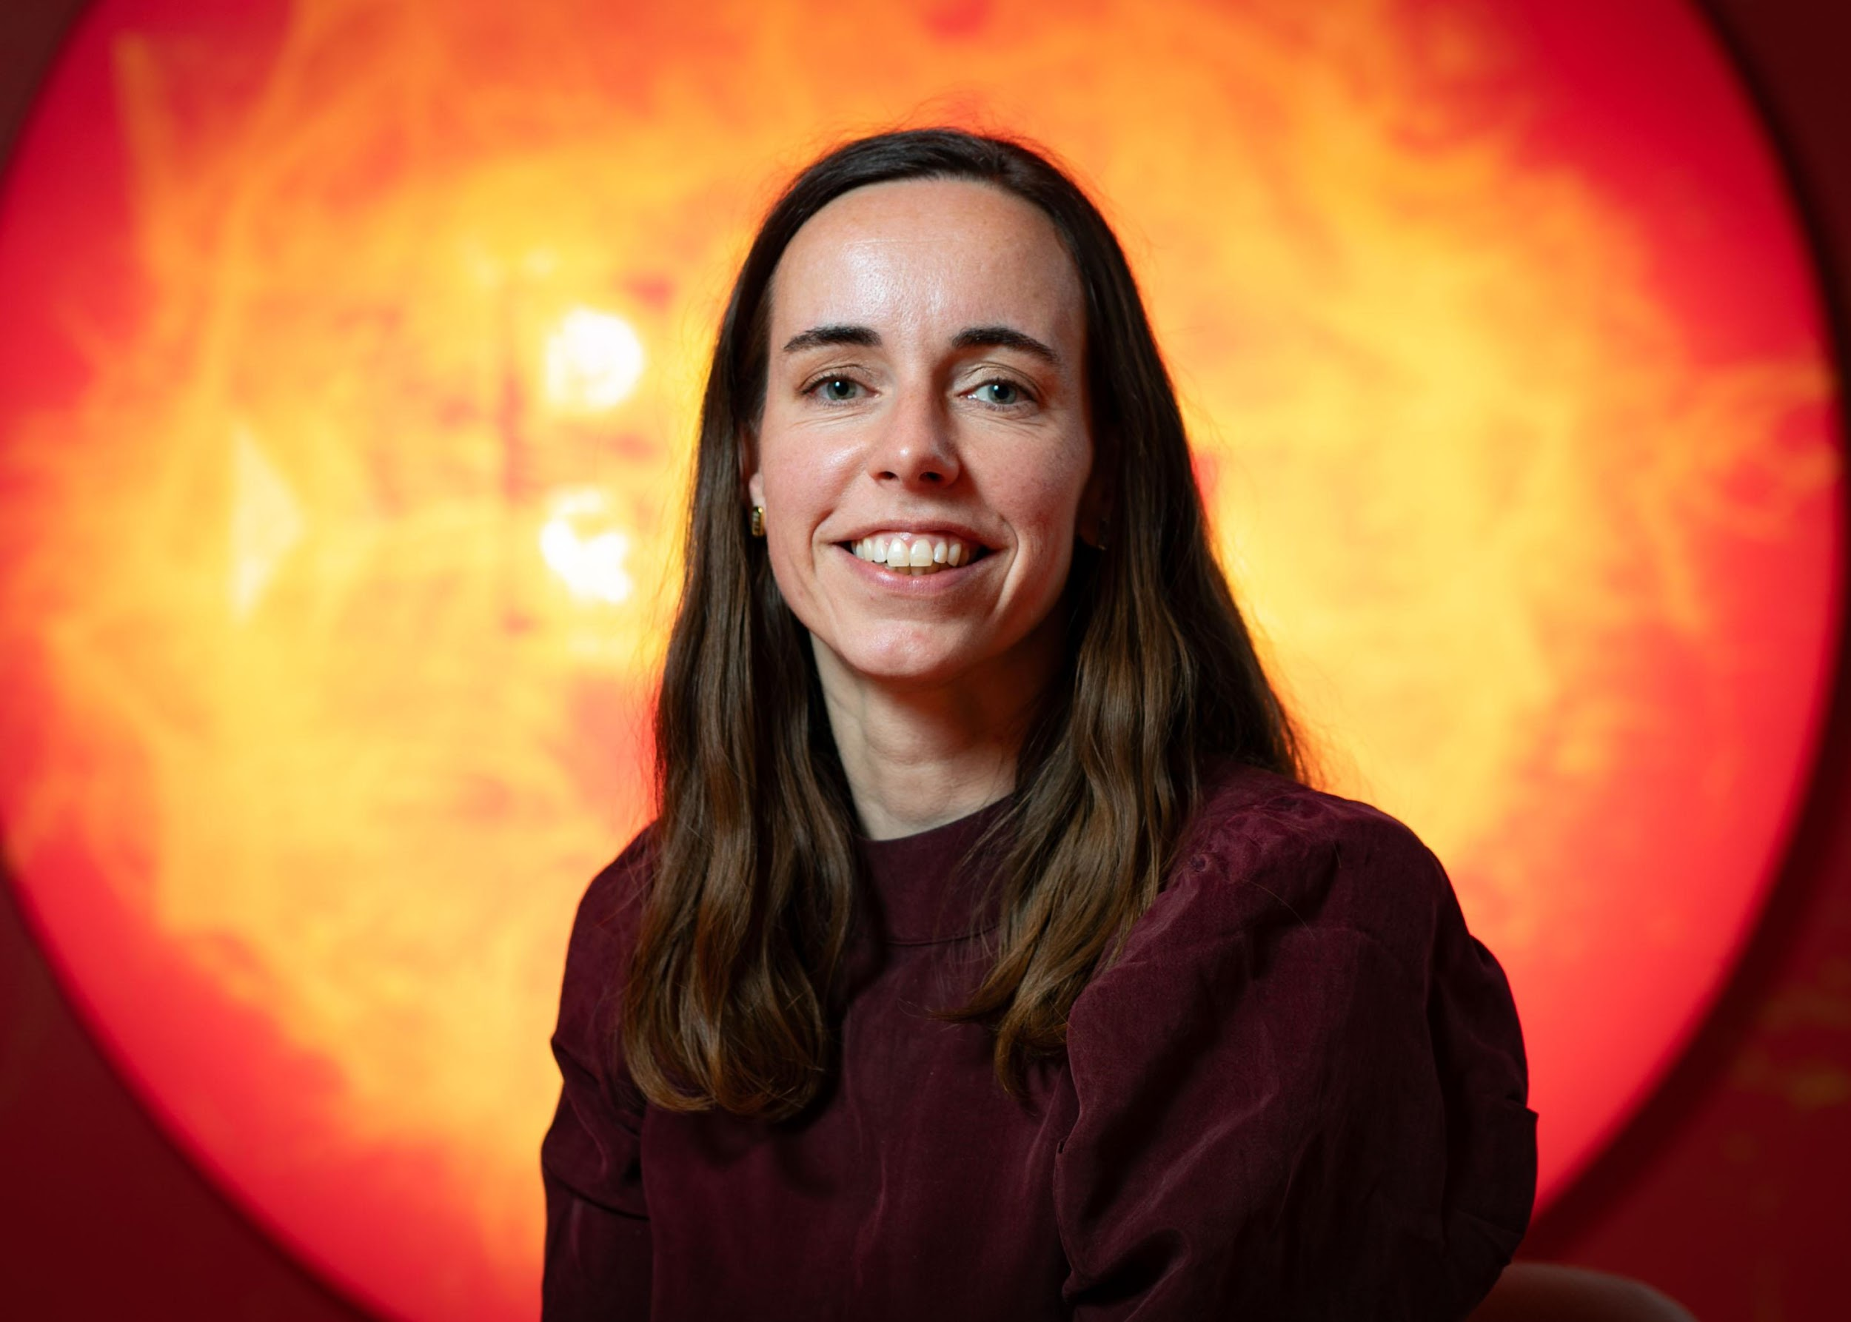
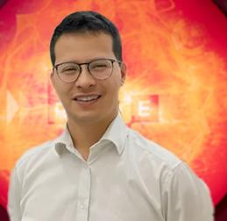
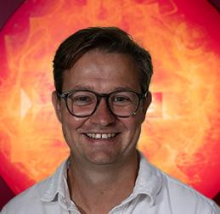
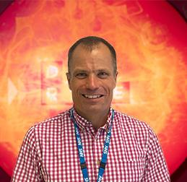
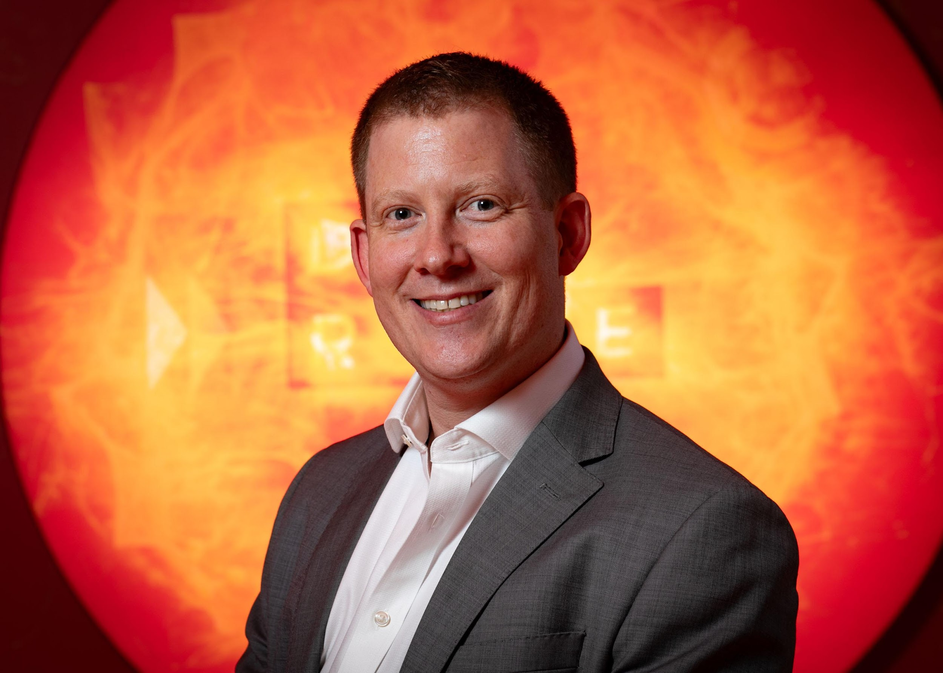
Clinical Innovation Officers
Dr Claire Edmondson Paediatric Respiratory Consultant
Pritesh Patel
Senior Specialist Pharmacist
Sally Tollerfield
Endocrine Clinical Nurse Specialist
Evelin Milev
Snr Clinical Research NMD Paediatric Physiotherapist
Zoe Hallett
General Manager for Brain Directorate
Dr Ed Gaynor
Paediatric Consultant Gastroenterologist
Maaike Kusters
Consultant Paediatric Immunologist
Colin Butler
Consultant ENT Surgeon
Dr Richard Issitt Senior Paediatric Perfusionist
Dr Wesley Hayes
Paediatric Nephrologist

Slide 12


CIU Insights
Outcomes - Project Based (Highlights)
Day Cases
Increased Nightingale activity by around 100 extra day cases per month
Business case approved to create capacity to take in all day cases patients on inpatient beds which would free up around 100 bed days per month in inpatients
~£3.2m annual increase in day case income from ERF (projected, based on ~£800k realised in Q1 FY24/25)
Labs Overtesting
£15,000 potential annual savings through reduced send away testing and test reagent usage
Projected £5000 cashable annual savings based on £1200 realised in FY24/25 Q1 (figure is increasing each quarter, so could be higher for full year)
Staff opportunity cost: >100 tests per month opportunity to reduce expensive send away testing through capacity to set up in-house testing at GOSH

Slide 13
CIU - Measuring what matters
‘Measure what is important, don’t make important what you can measure’ (Robert McNamara)
Benefit | Description | What to measure
Financial | Income increase, outgoing reduction | Financial
Clinical effectiveness (short and long term) | Treatment effectiveness, increased quality of life and life expectancy, PROMS | Quality adjusted life years, length of stay, readmission rates,
Patient, family experience | Impacts to mental health and wellbeing, sentiment to GOSH | PREMS, FFT sentiment, cancellations
Staff experience | Mental and physical wellbeing, discretionary effort, feeling of belonging | Staff sentiment, sick days, retention, cancellations
Safety | Reducing the safety risks and mitigating harm from incidents | Incident rates / severity reduction
Quality | Safety, Clinical effectiveness, Experience | CQC benefit – financial?
Efficiency | Reducing effort to achieve the same thing, saving time and/or stress | Time (can be accounted for in financial terms)
Health (in)equality | Making care more equitable | Health Inequality metrics

Slide 14
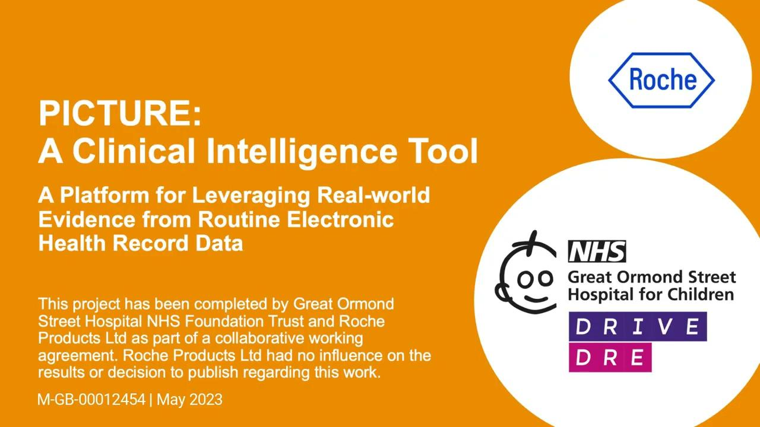
Clinical Decision Support
We are laying the foundations…

Slide 15
Enhancing precision medicine & scientific engagement

Slide 16
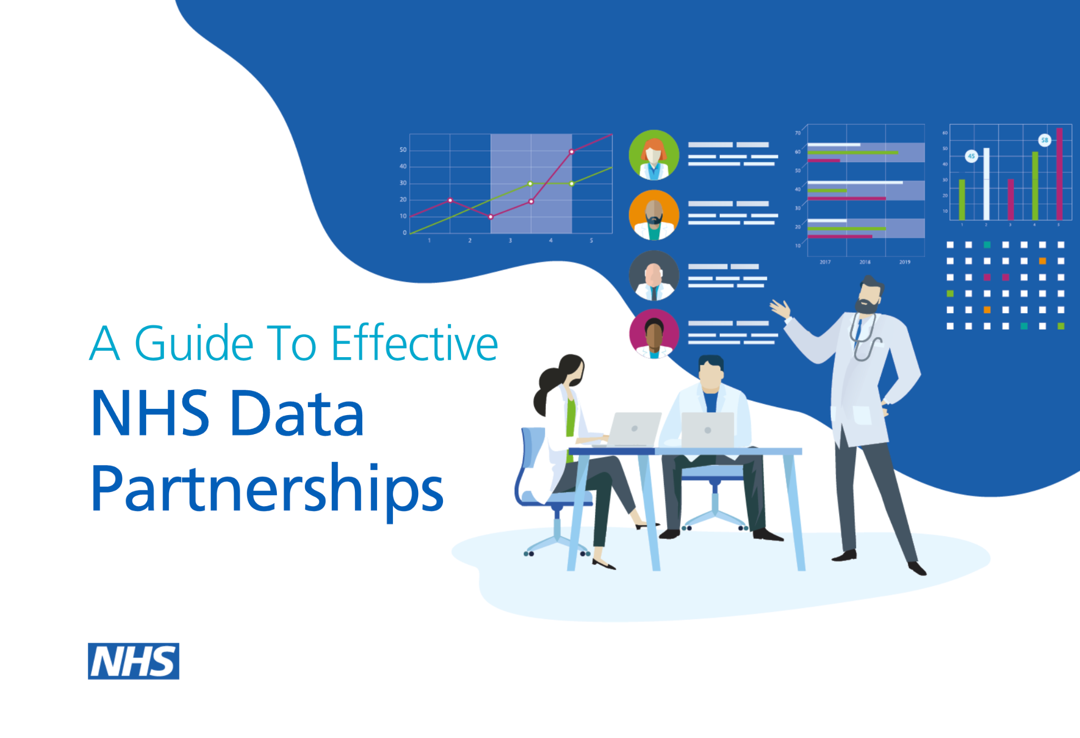
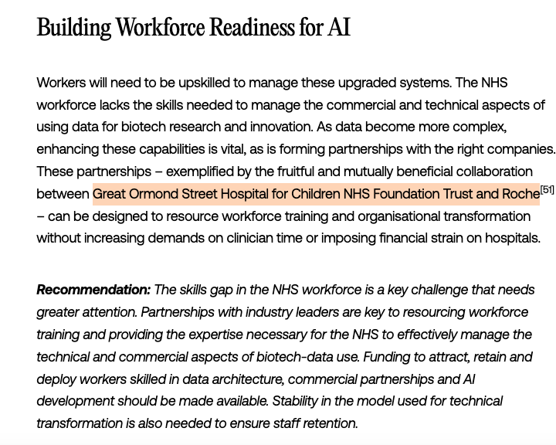
Great Ormond Street Hospital (GOSH):
The Reaction
Source (NHS England)
Source Tony Blair Institute

Slide 17
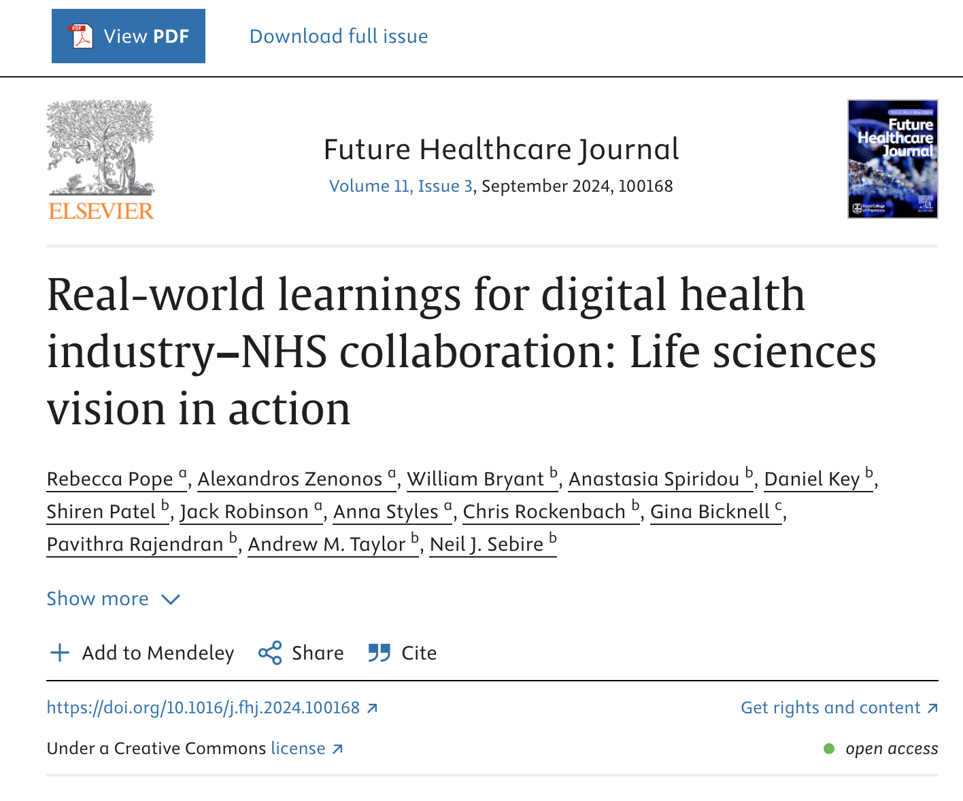
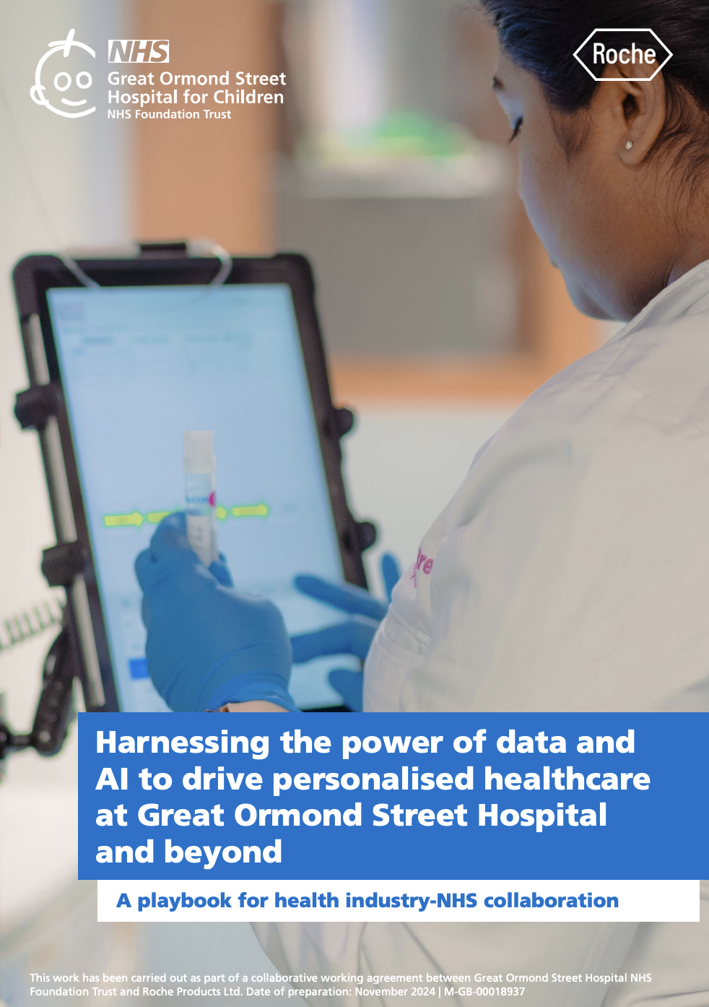
Sharing our work across the NHS & beyond
Source
Source

Slide 18
Take home messages

Slide 19
“It’s always impossible until it’s done.”

Slide 20

But it takes a village…
20+
Clinicians
Project Managers
Data Scientists
Data Engineers
Software Engineers
Managers
Administrators

Slide 21
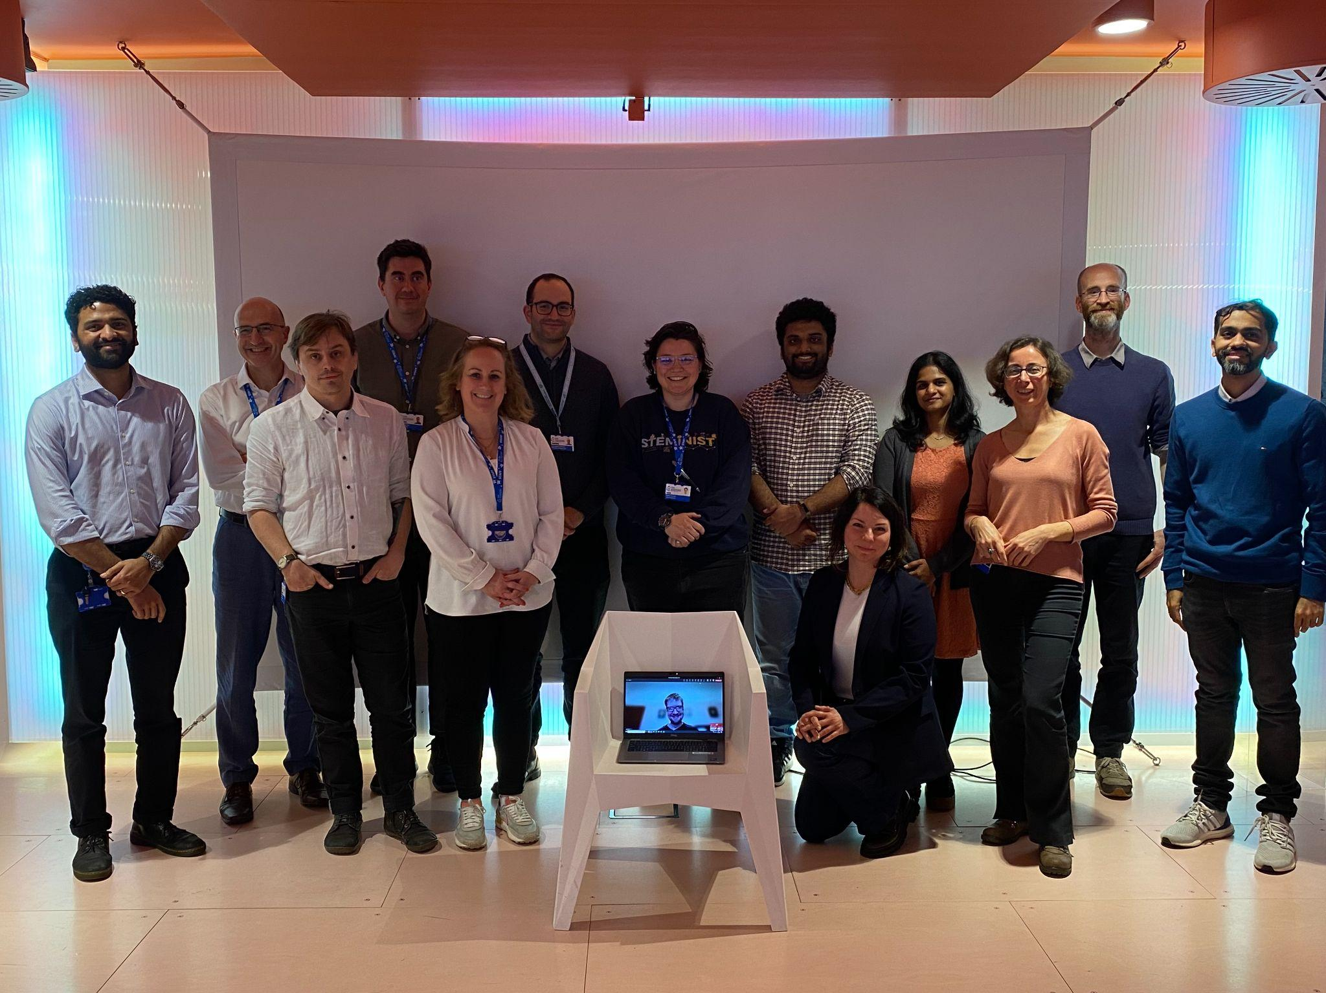
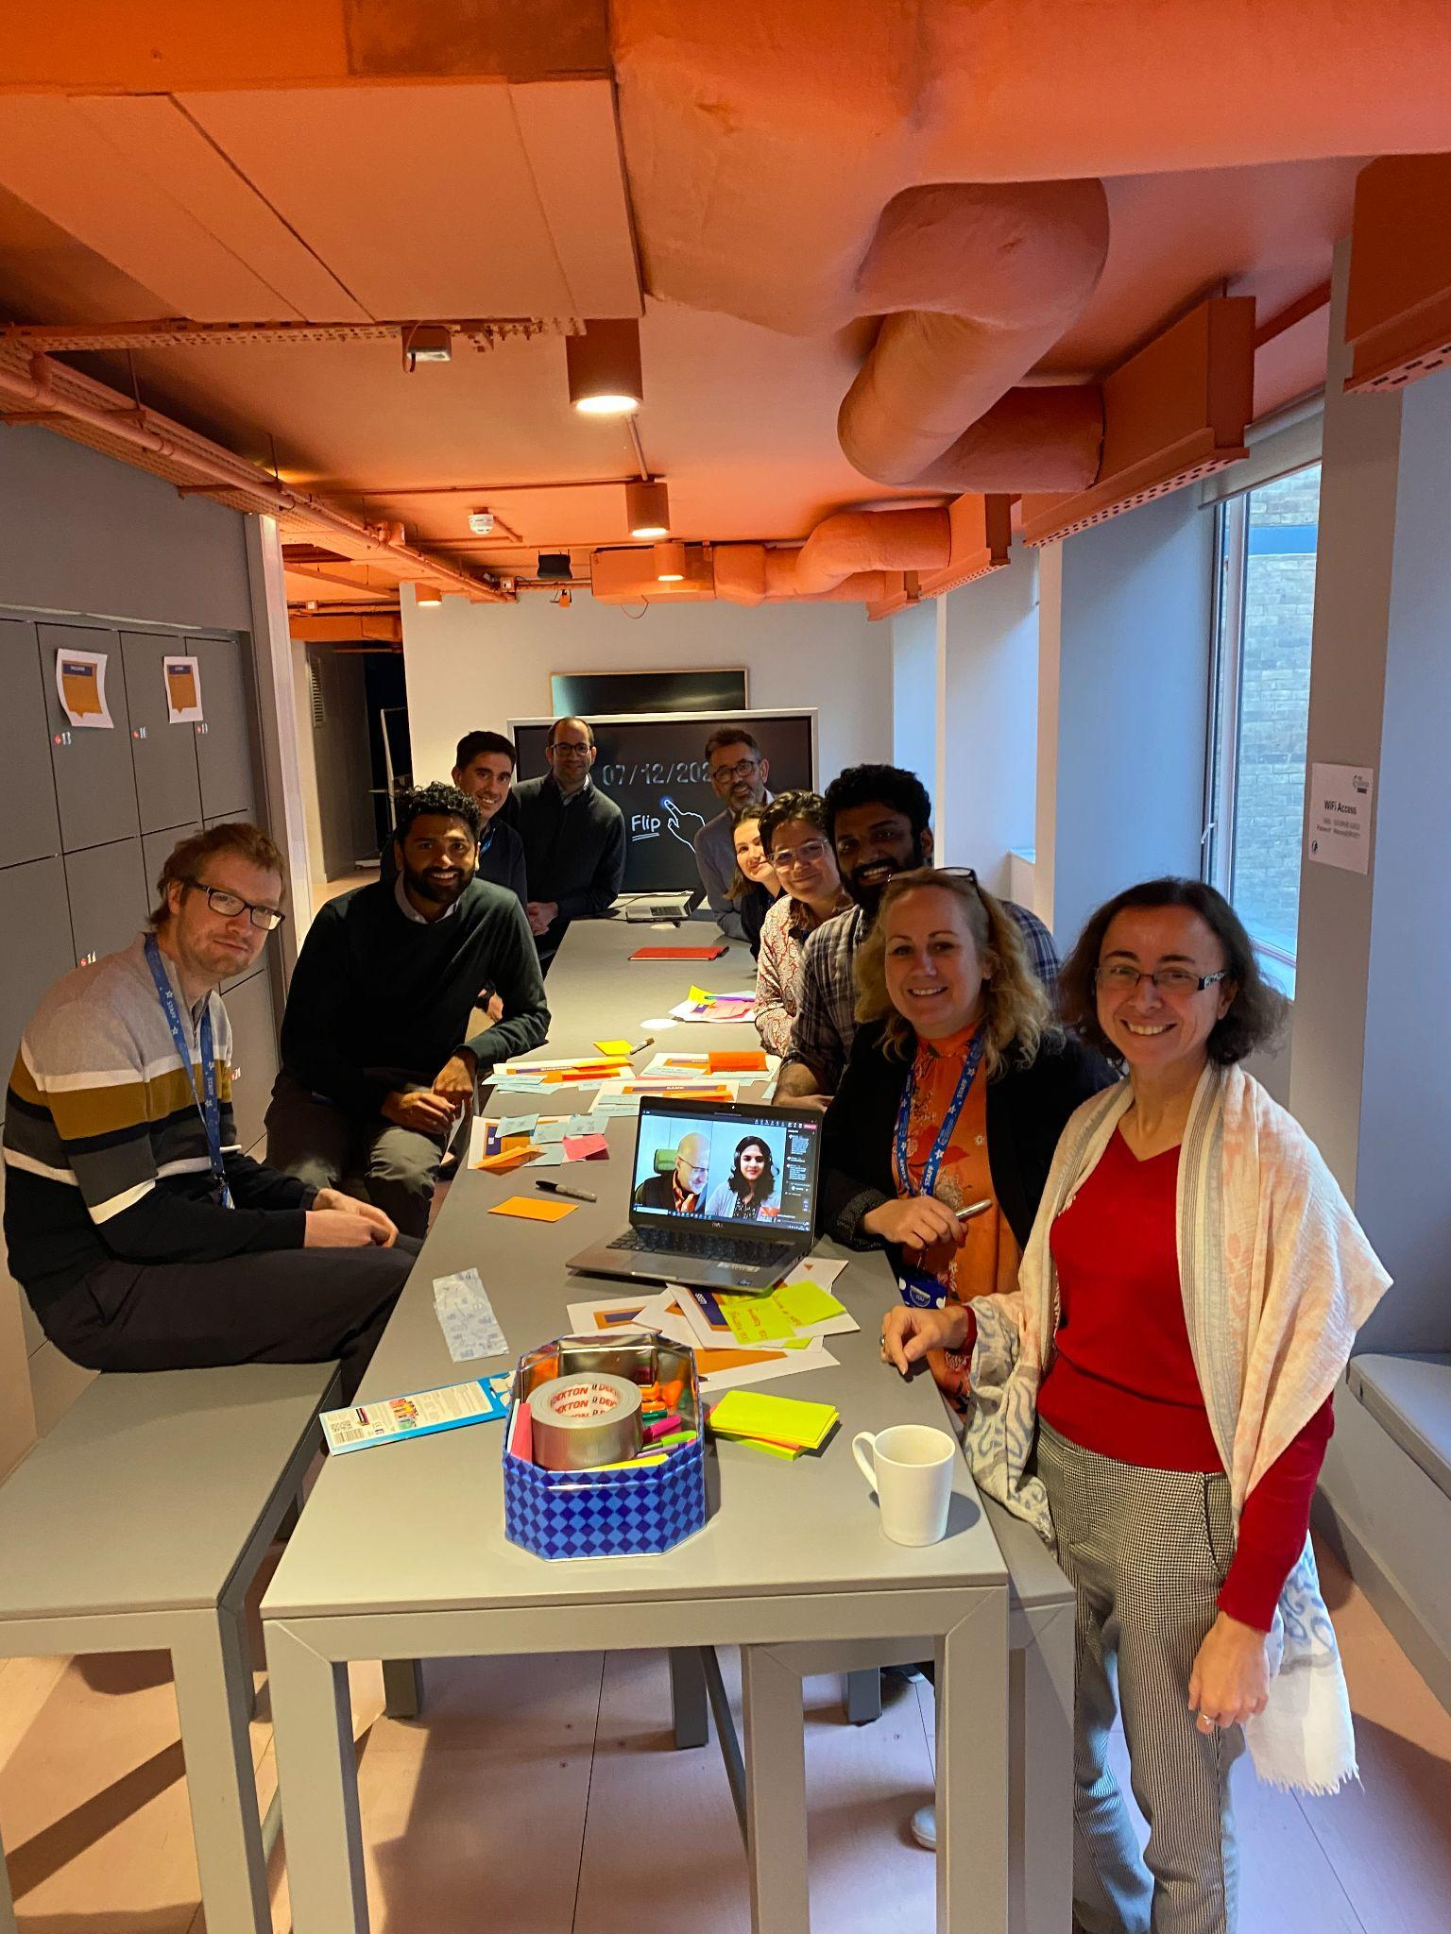
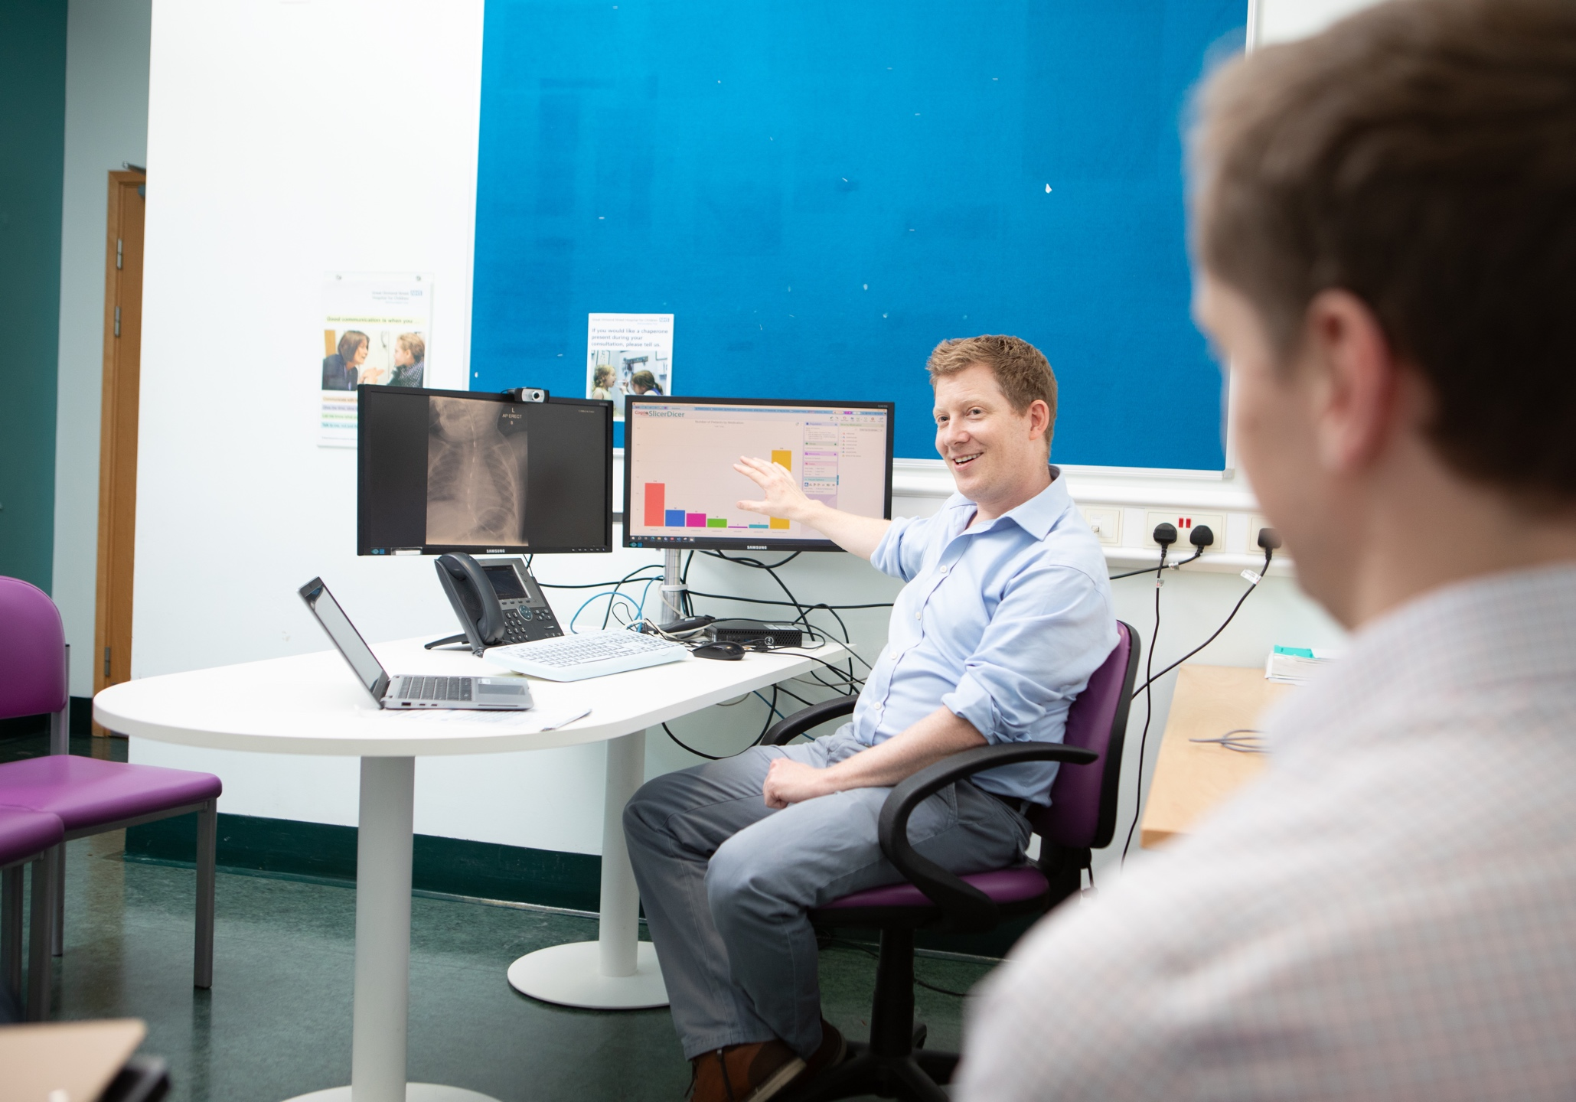

Thank you to the entire Roche-GOSH team!

Slide 22

Questions
There’s no such thing as a ‘silly’ one!

